Slide 1
Japanese knives sales prediction
Nekender Shekhawat

Slide 2
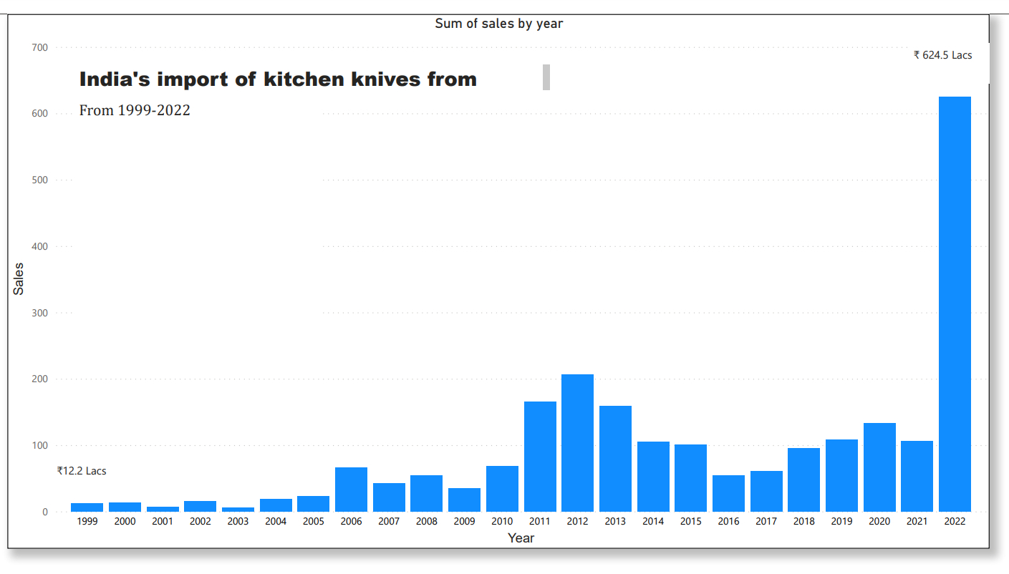
India’s import of kitchen knives from Japan has shown a fluctuating pattern but in 2022 it boomed at a total import cost of 624.5 lacs
It shows that there is a potential in the Japanese kitchen knives market right now

Slide 3
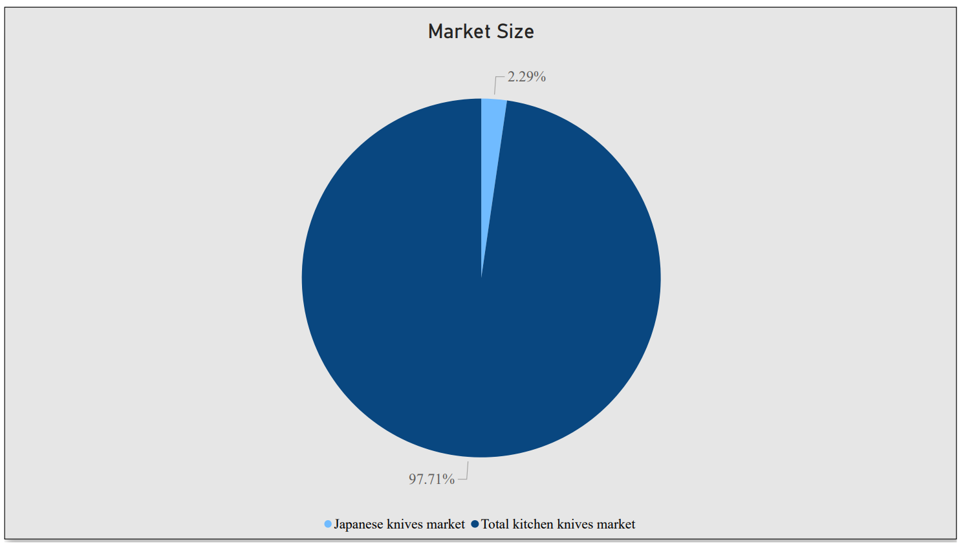
According to data collected from Ministry of commerce and industries website Japanese kitchen knives in India accounts for 2.29 % of total kitchen knives market

Slide 4
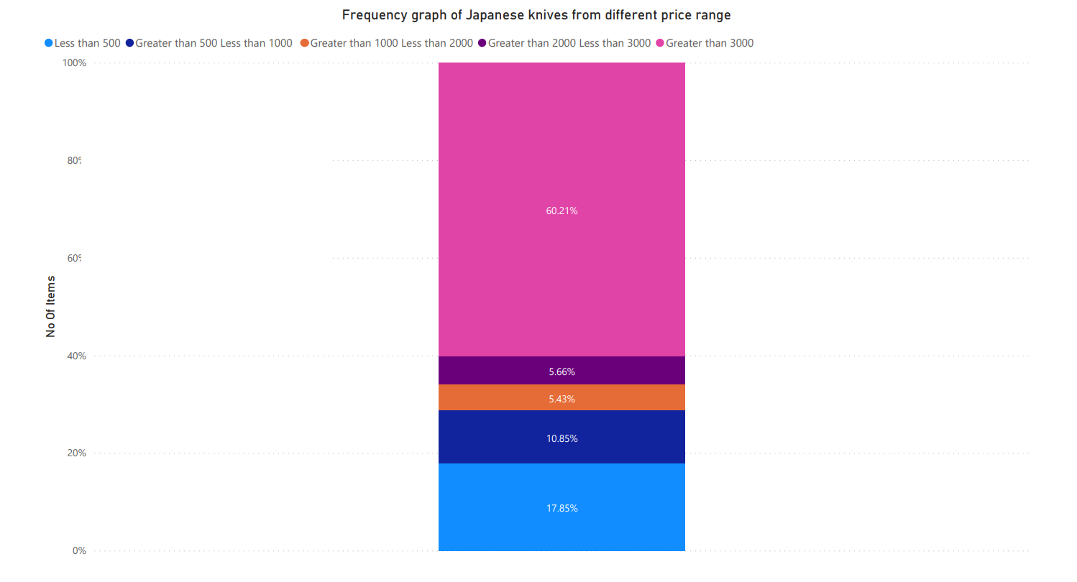
According to data collected from amazon.in over 60% of the Japanese kitchen knives sold on their website are above 3000 rupees
This indicates that Japanese knives market is a premium market and can be very profitable

Slide 5
Top Brands
This competition is driving innovation and product development, with many companies introducing new products to meet changing consumer demands and stay ahead of the competition. Manufacturers are focused on bringing new products to the market to gain a competitive edge and increase their sales. This includes introducing new materials, designs, and features that offer superior performance, durability, and convenience. For instance, Kai brings over 800 years old Japanese legacy of forging blades directly to the kitchen of Indian households .
From the data collected from amazon.in it can be seen that the key companies operating in the Indian Japanese kitchen knives market are:
Kai
Global
Miyabi
Leeonz Santoku
Nanfang Brothers

Slide 6
REPORT
ATTRIBUTES | DETAILS
Historical data | 2000-2023
Forecast period | 2023-2030
Estimated growth rate by 2030 | CAGR of 12.38% from 2023 to 2030
Market size in 2023 | Rupees 10.7 Cr.
Market size by 2030 | Rupees 19.2 Cr.
Report coverage | Import trends, market size, market share, competition, pricing, distribution channels
Quantitative unit | Revenue in Rs. Lacs and Quantity in Thousands
Country scope | India

Slide 7
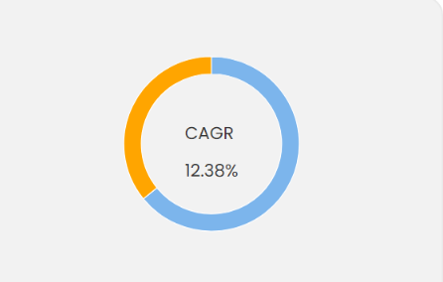

Slide 8
Data Sources
Amazon.in
tradestat.commerce.gov.in

